Slide 1
Ingvaeonic Society Policy on Clergy and Congregation Recognition
Familiarization Training

Slide 2
Core Concepts
Tiers of Priesthood (Sácerdhad)
Æweard
Wígbed-þegen
Ealdorssácerd
Forming a Congregation
Gemōt – A Provisional Group
Geferscipe – A Ratified Group

Slide 3
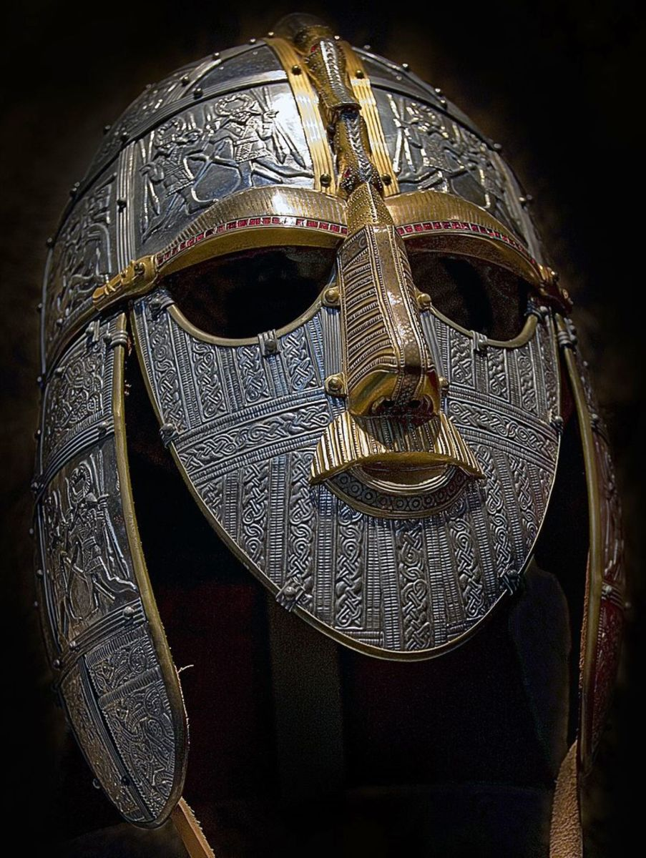
Tiers of Sácerdhad Participation
Æweard
Role: Trainee or assistant in community religious gatherings.
Ordination: Not Ordained.
Voting Rights: Non-voting member of the Society.
Responsibilities: Participate in training, assist in religious activities, perform household rites.

Slide 4
What does an Æweard do?
"Æweard" is not a reserved title. It can be self-applied by anyone wishing to pursue spiritual enrichment as a volunteer clergy person. It can also describe someone in the initial steps of clergy training within the Ingvaeonic Society. An Ingwine who has commited themselves to leading or conducting sacrifices on a family or informal level may also use this term.

Slide 5
Tiers of Sácerdhad Participation
Wígbed-þegen
Role: Clergy member.
Ordination: Ordained.
Voting Rights: Non-voting member of the Society.
Responsibilities: Can found a provisional group, lead local congregations under supervision.
Path to Ealdor: Must complete priesthood training and serve as a non-voting member for one year before becoming eligible for the Ealdor role.

Slide 6
What does an Wígbed-þegen do?
A Wígbed-þegen assists in large group gatherings and performs various ritual roles for which they are qualified. They can conduct weddings and funeral rites, teach the religion to new members, and if they wish, form a provisional congregation. The Wígbed-þegen is ordained by the Society, upon the candidate’s request, and upon the candidate enrolling in the clergy training program. This role is ideal for those beginning their journey in clergy training, offering opportunities for volunteer involvement and community service without requiring ordination. Additionally, they may seek certification for promotion to Ealdor, the highest clergy tier.

Slide 7
Tiers of Sácerdhad Participation
Ealdorsácerd (Ealdor)
Role: Leader of the congregation.
Ordination: Ordained.
Voting Rights: Voting member of the corporation.
Responsibilities: Lead the local congregation, participate in corporate decision-making.

Slide 8
What does an Ealdor do?
An Ealdor is the leader of a fully recognized congregation, or Geferscipe, within the Ingvaeonic Society. The Ealdor is responsible for guiding their community in religious practices, teaching, and overall spiritual well-being. As a voting member of the corporation, the Ealdor represents their congregation's interests in the Ge-þingþu (assembly), ensuring that their voices are heard in the broader governance of the society. This role is pivotal in maintaining the connection between local congregations and the overarching structure of the Ingvaeonic Society.

Slide 9
Forming a Congregation
How to do it!

Slide 10
Forming a Hired
Provisional Group Recognition
Formation: A Wígbed-þegen can establish a provisional group, termed a “Hired”.
Training and Evaluation: The responsible (founding) Wígbed-þegen must complete priesthood training and receive the Ealdor Certification, before recognition as an Ealdor will be considered. The group should remain active and submit a yearly Communication Plan.
Duration: The responsible Wígbed-þegen must serve as a non-voting member of the Society (not necessarily as a cleric) for at least one year.
Full Recognition: After meeting training and duration requirements, the provisional group can be recognized as a full congregation by the Board, and the responsible Wígbed-þegen can be elevated to Ealdor.
To form a provisional congregation, a Wígbed-þegen can establish a Hired, an informal gathering for religious and community activities. This Hired operates under the guidance of the Wígbed-þegen, who must complete their priesthood training and serve as a non-voting member for one year. During this time, the Hired can grow and develop its practices and community presence. Once the Wígbed-þegen meets the training and duration requirements, the Hired can apply for full recognition. To do so, the group MUST include going forward, at least one person of gesiþ status among its membership, with the sole exception being, the practicing spouse of a Wígbed-þegen counts as a gesiþ for this purpose only. Upon approval, the Hired is ratified as a Geferscipe, a fully recognized religious house within the Ingvaeonic Society, led by an Ealdor who becomes a voting member of the corporation. This process ensures the integrity and stability of new congregations while fostering growth and community involvement.

Slide 11
Now your group is a Geferscipe!
Continue to submit Communication Plan yearly.
The responsible Ealdor must pay IF Membership dues promptly.
The Ealdor represents the group in the voting assembly, or Ge-þincþu.

Slide 12
When Leadership Changes…
When leadership changes, the group must have an “Ealdor certified” Wígbed-þegen in place to assume the mantle of Ealdor.

Slide 13
Questions?

